Slide 1
Dynamic Programming
Part-2

Slide 2
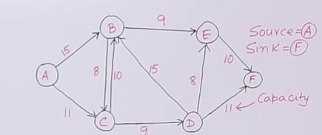
Ford-Fulkerson Algorithm for Maximum Flow Problem
Given a graph which represents a flow network where every edge has a capacity. Also given two vertices Source S and sink T in the graph. Find out the maximum possible flow from S to T with following constraints.
a) Flow on an edge doesn't exceed the given capacity
b) In-flow is equal to Out-flow for every vertex except S and T
Ford-Fulkerson Algorithm
The following is a simple idea of the algorithm
1) Start with a initial flow as 0 (zero).
2) While there is an augmenting path from source to sink, Add this path flow to flow
3) Return flow
Terminologies
* Residual Graph: It's a graph which indicates additional possible flow. If there is such path from Source to sink, then there is a possibility to add flow.
* Residual Capacity: It's original capacity of the edge minus flow.
* Minimal cut: Also known as bottle neck capacity, which decides maximum possible flow from Source to sink through an augmented path
* Augmenting path: Augmenting path can be done in two ways -
1)Non-full forward edges
2) Non-empty back ward edges

Slide 3
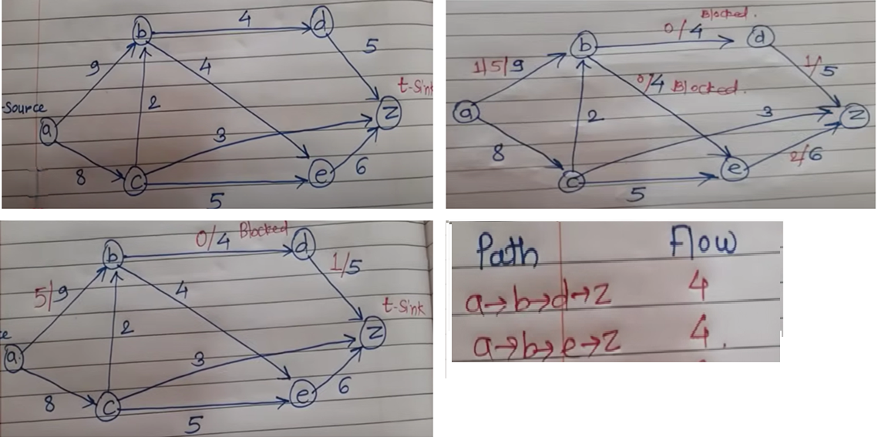

Slide 4
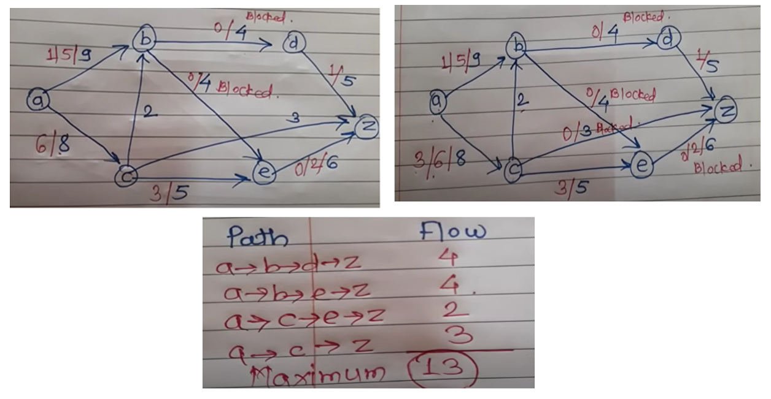

Slide 5
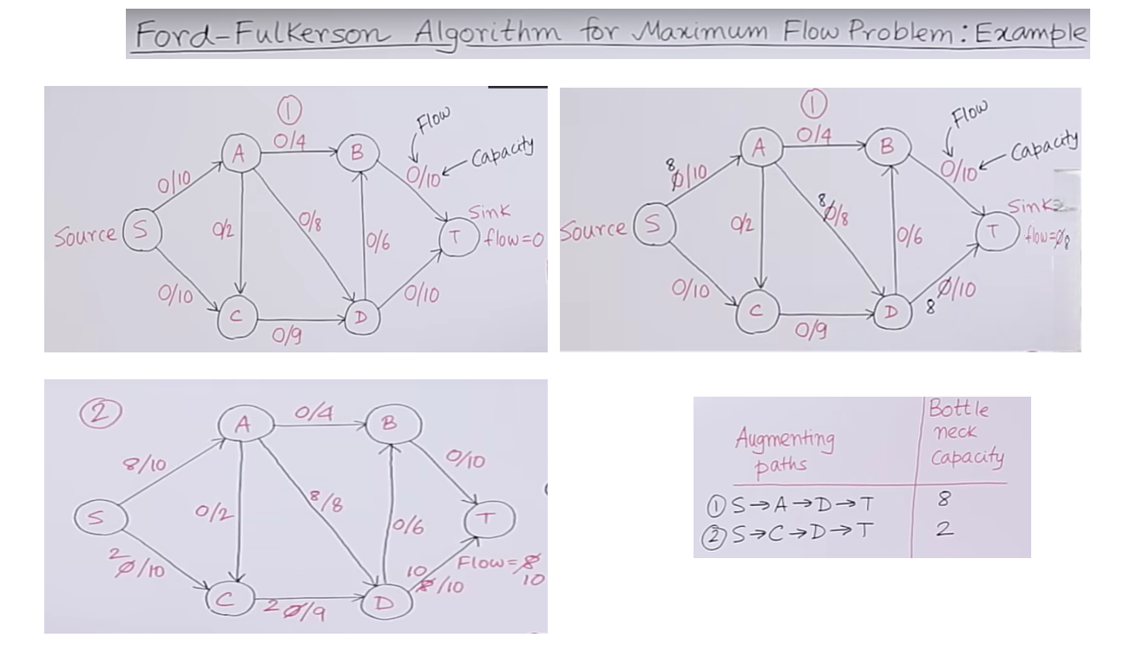

Slide 6
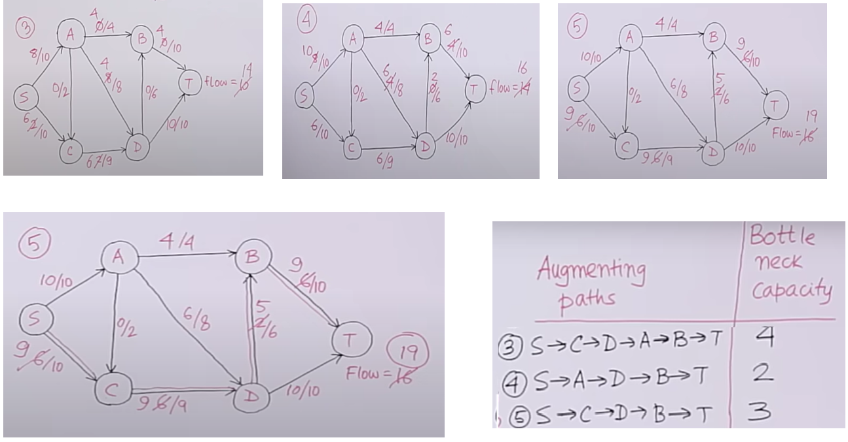

Slide 7
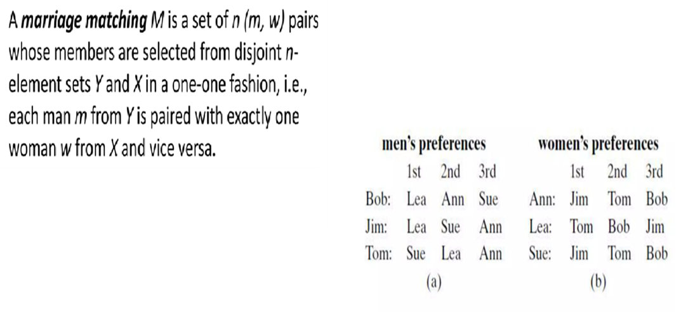
Stable Marriage Problem

Slide 8
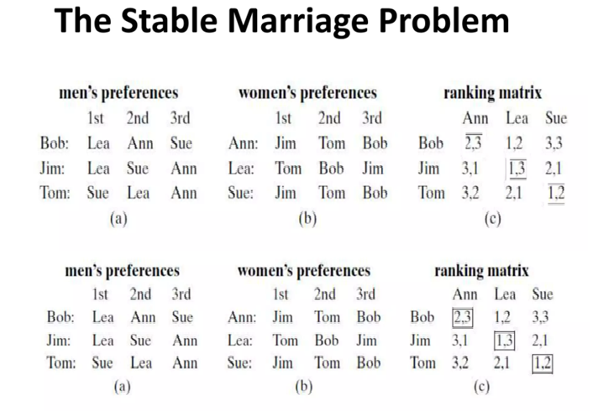

Slide 9
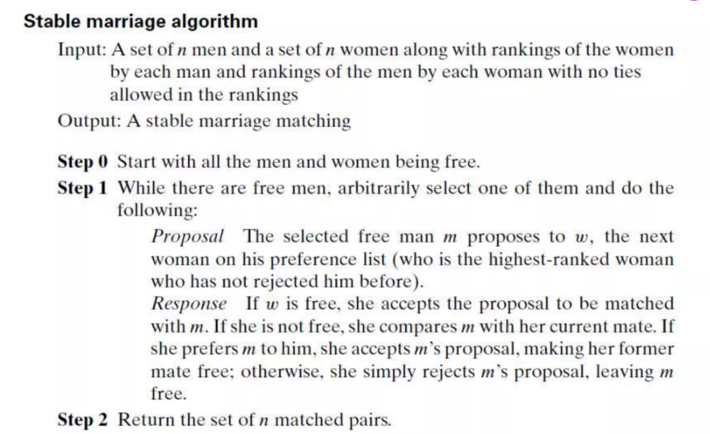

Slide 10
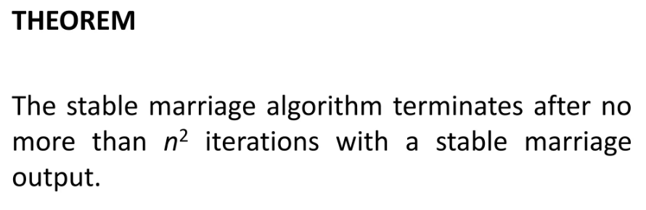
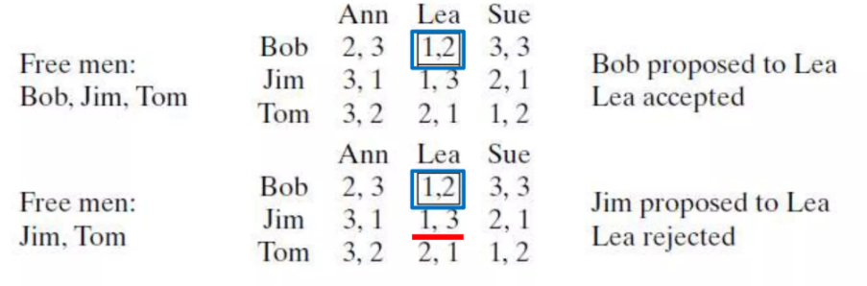

Slide 11
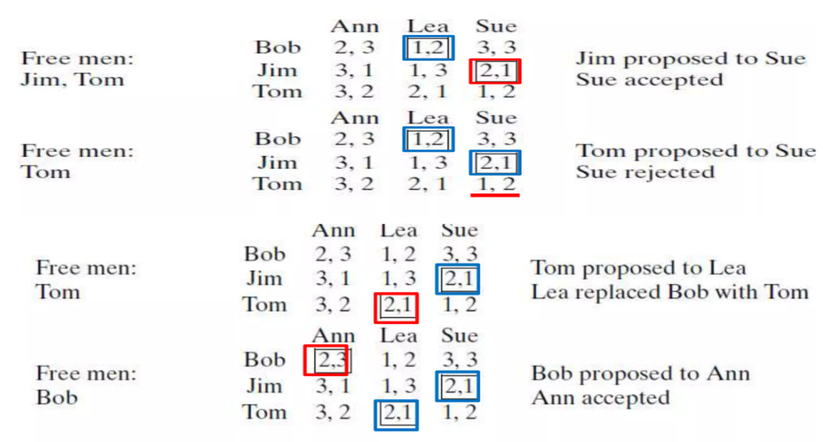

Slide 12
